Slide 1
Image Scrambler Password
Team 13: Maxwell Warncke, Daniel Rochefort, Doehoon Kim, Richmond Azumah

Slide 2
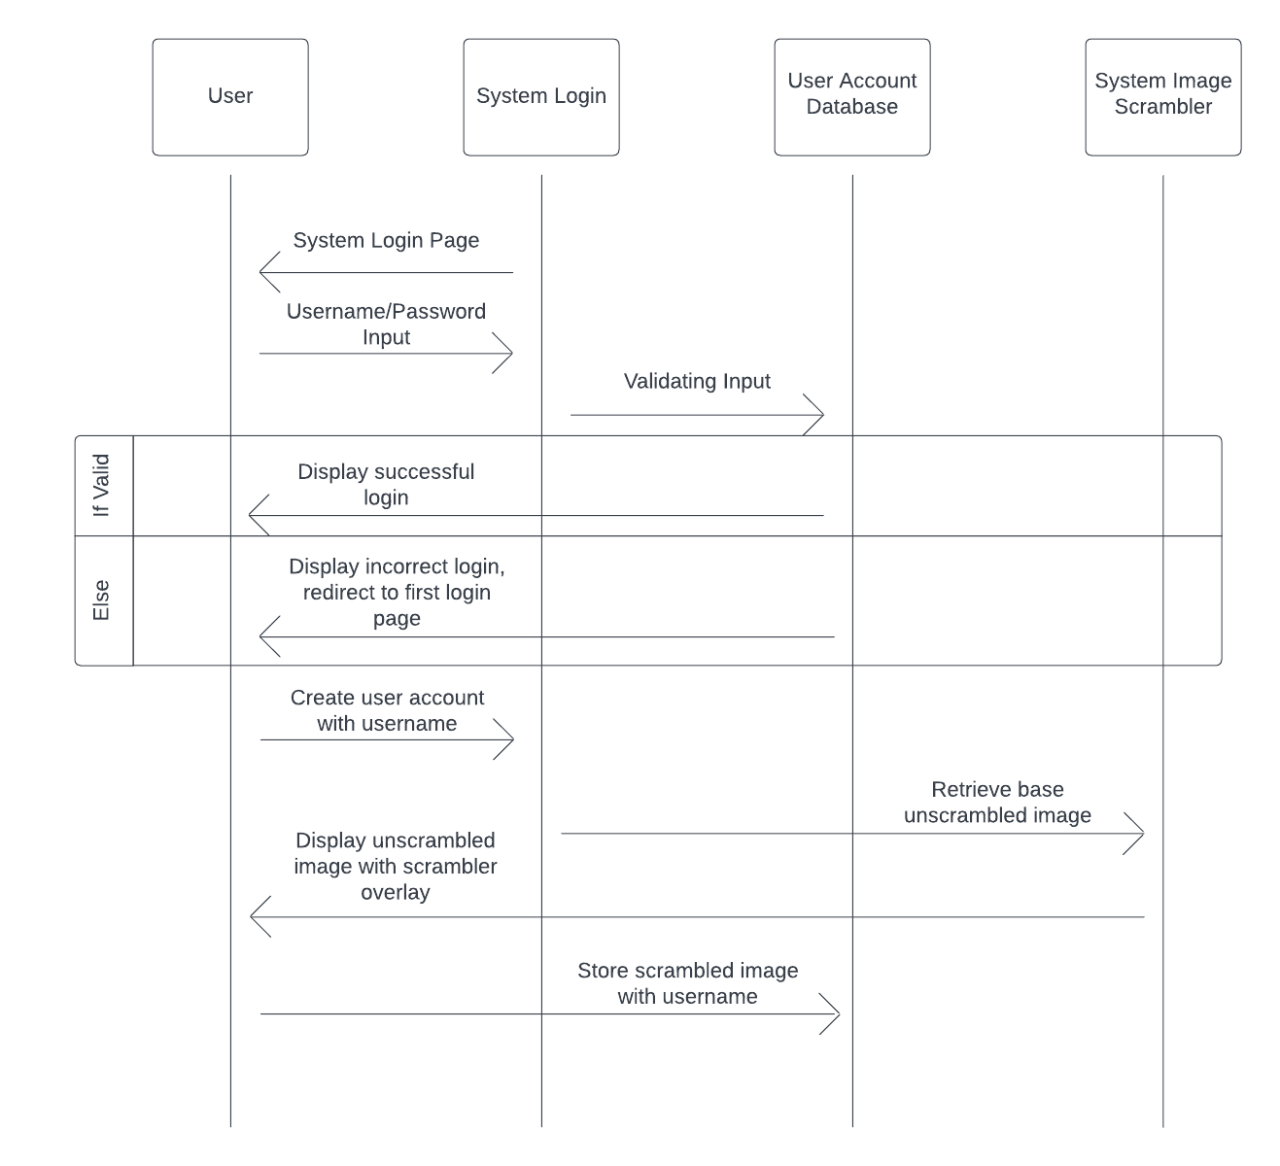
UML
Sequence
Diagram:

Slide 3
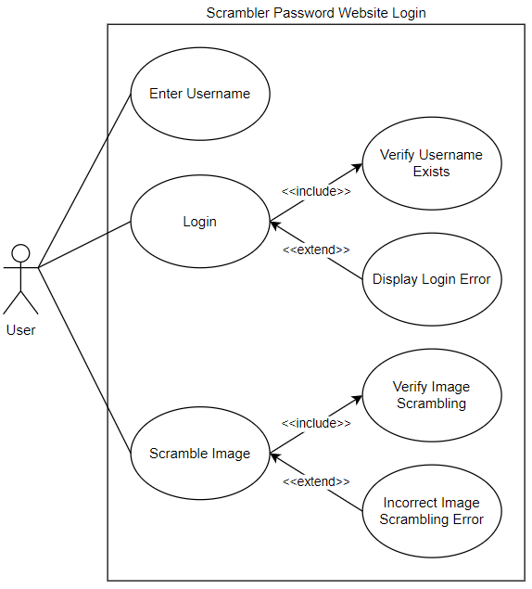
Use Case
Diagram 1

Slide 4
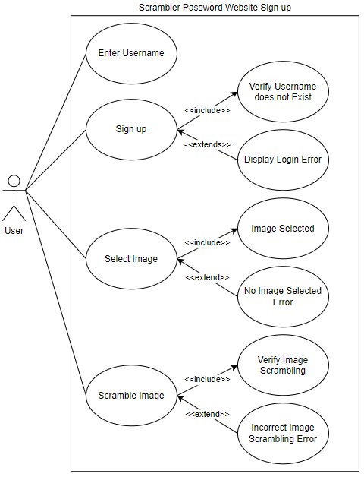
Use Case
Diagram 2

Slide 5
Test Case Scenarios
Test Case: Verify the user has to input a username, and it must be only alphanumeric characters
Input: “Test*Username”
Expected output: Username must be only alphanumeric characters. Please try again
Test Case: Verify the user cannot sign up without selecting an image
Input: User clicks “Next” button to attempt to move onto scrambling
Expected output: Please select one of the image.
Test Case: Verify the user cannot submit an unscrambled image as a password
Input: User clicks “Submit” without scrambling the image
Expected output: Image must be scrambled, Please try again.

